Slide 1
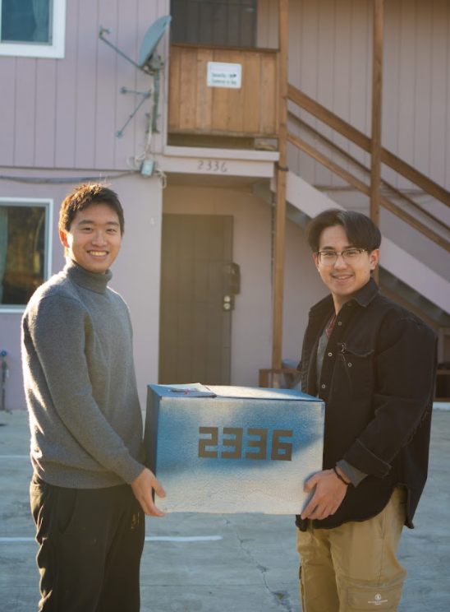
The 2336 Box
By Ricky Han and Jacky Li
ME100 Final Project

Slide 2
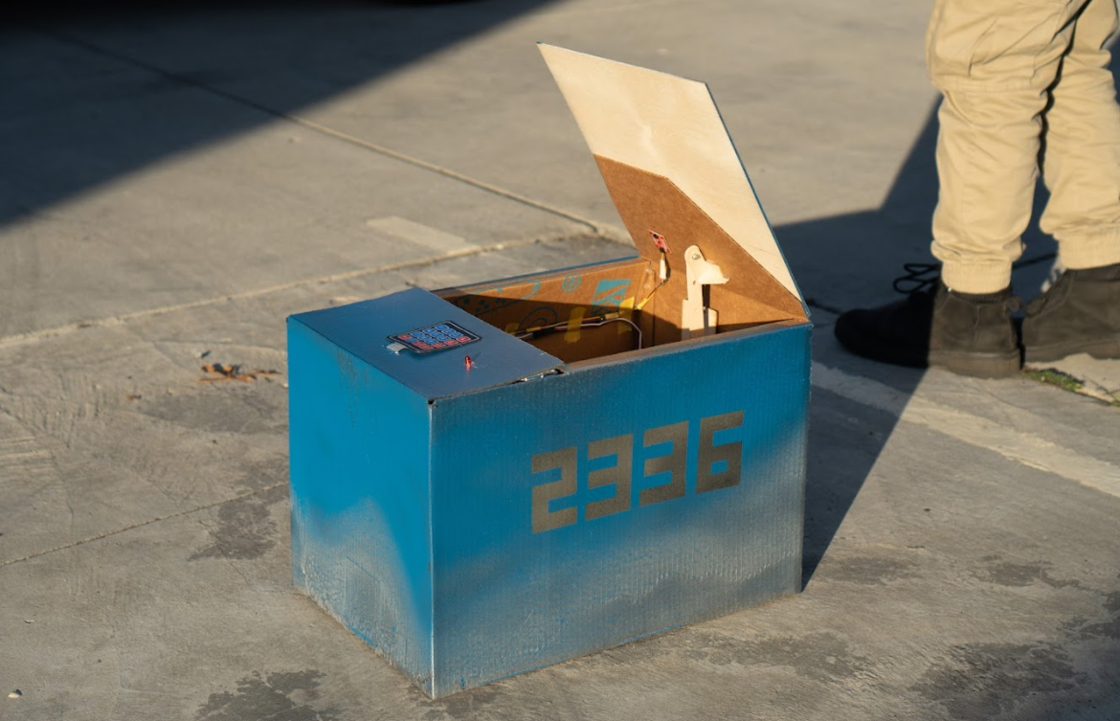
What the box does...
The 2336 box is a smart delivery box that can receive and weigh your package. It informs you via phone calls that you have a package delivered. It also has anti-theft mechanism that protects your packages from being stolen.

Slide 3

Video Demonstration

Slide 4
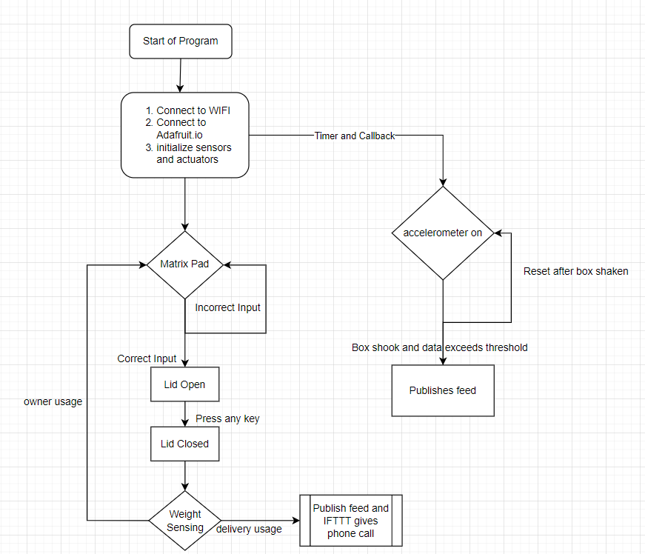
Computation (Main Control)

Slide 5
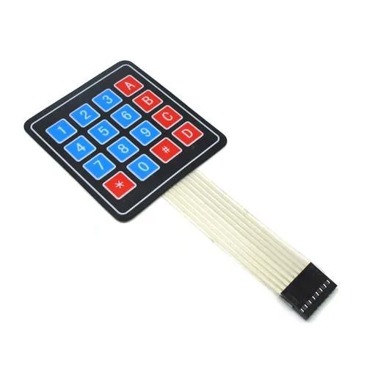
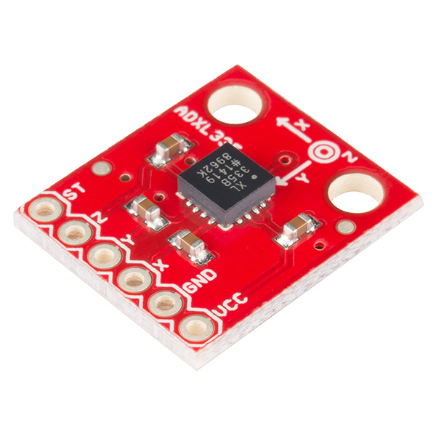
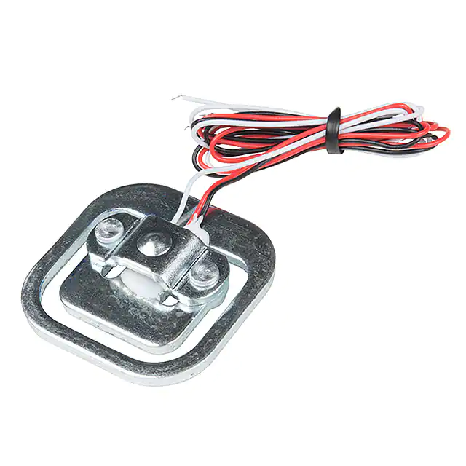
Sensors
Accelerometer (theft detection)
4 Strain Gauges (weight measurement)
Matrix Pad (for password input)

Slide 6
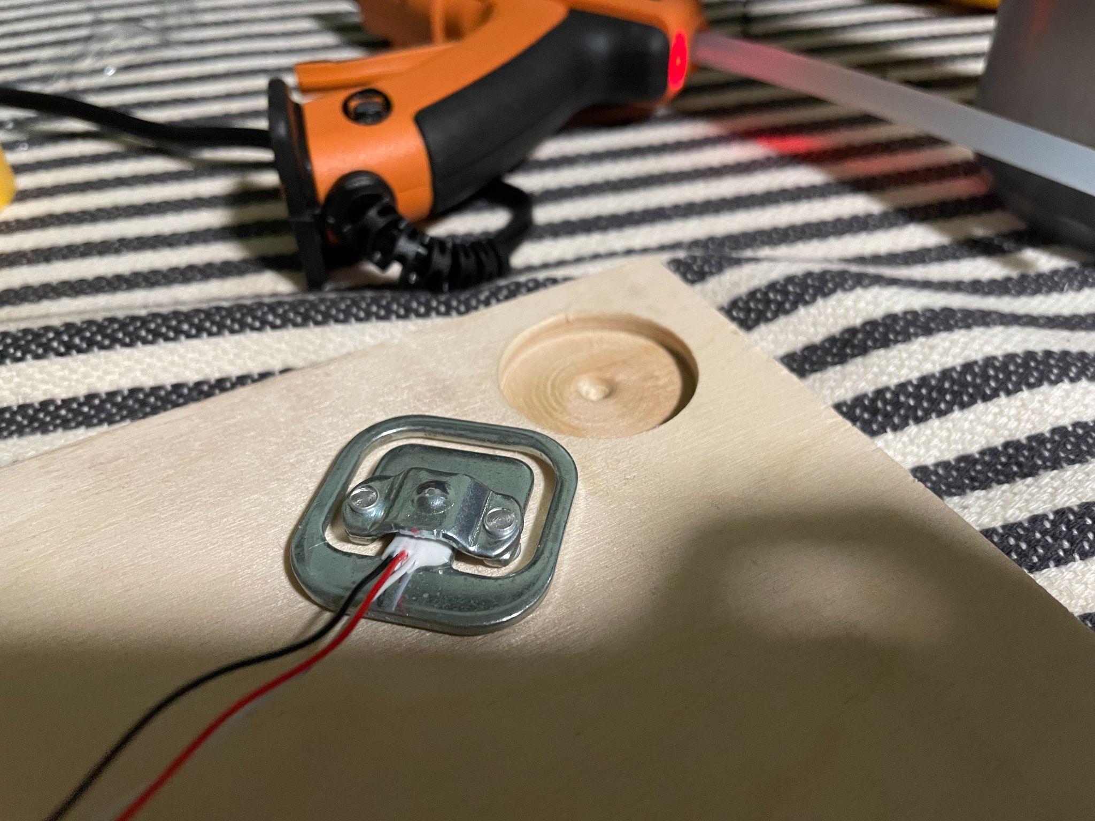
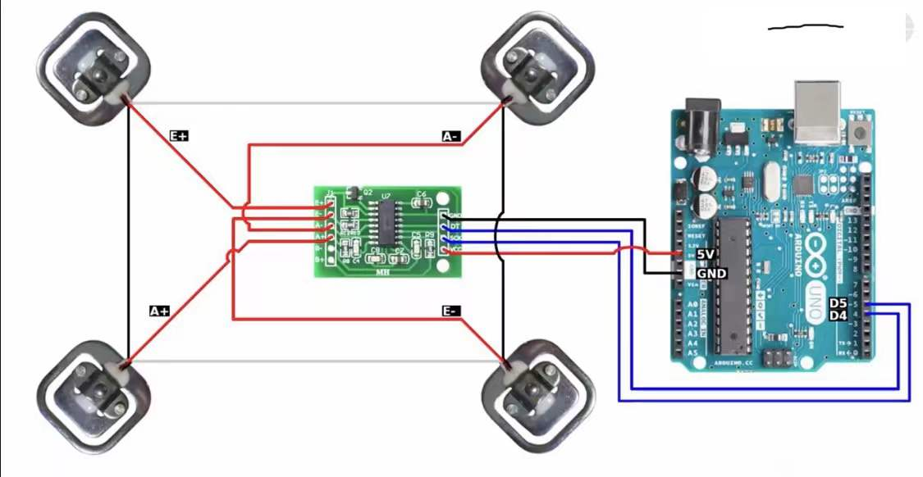
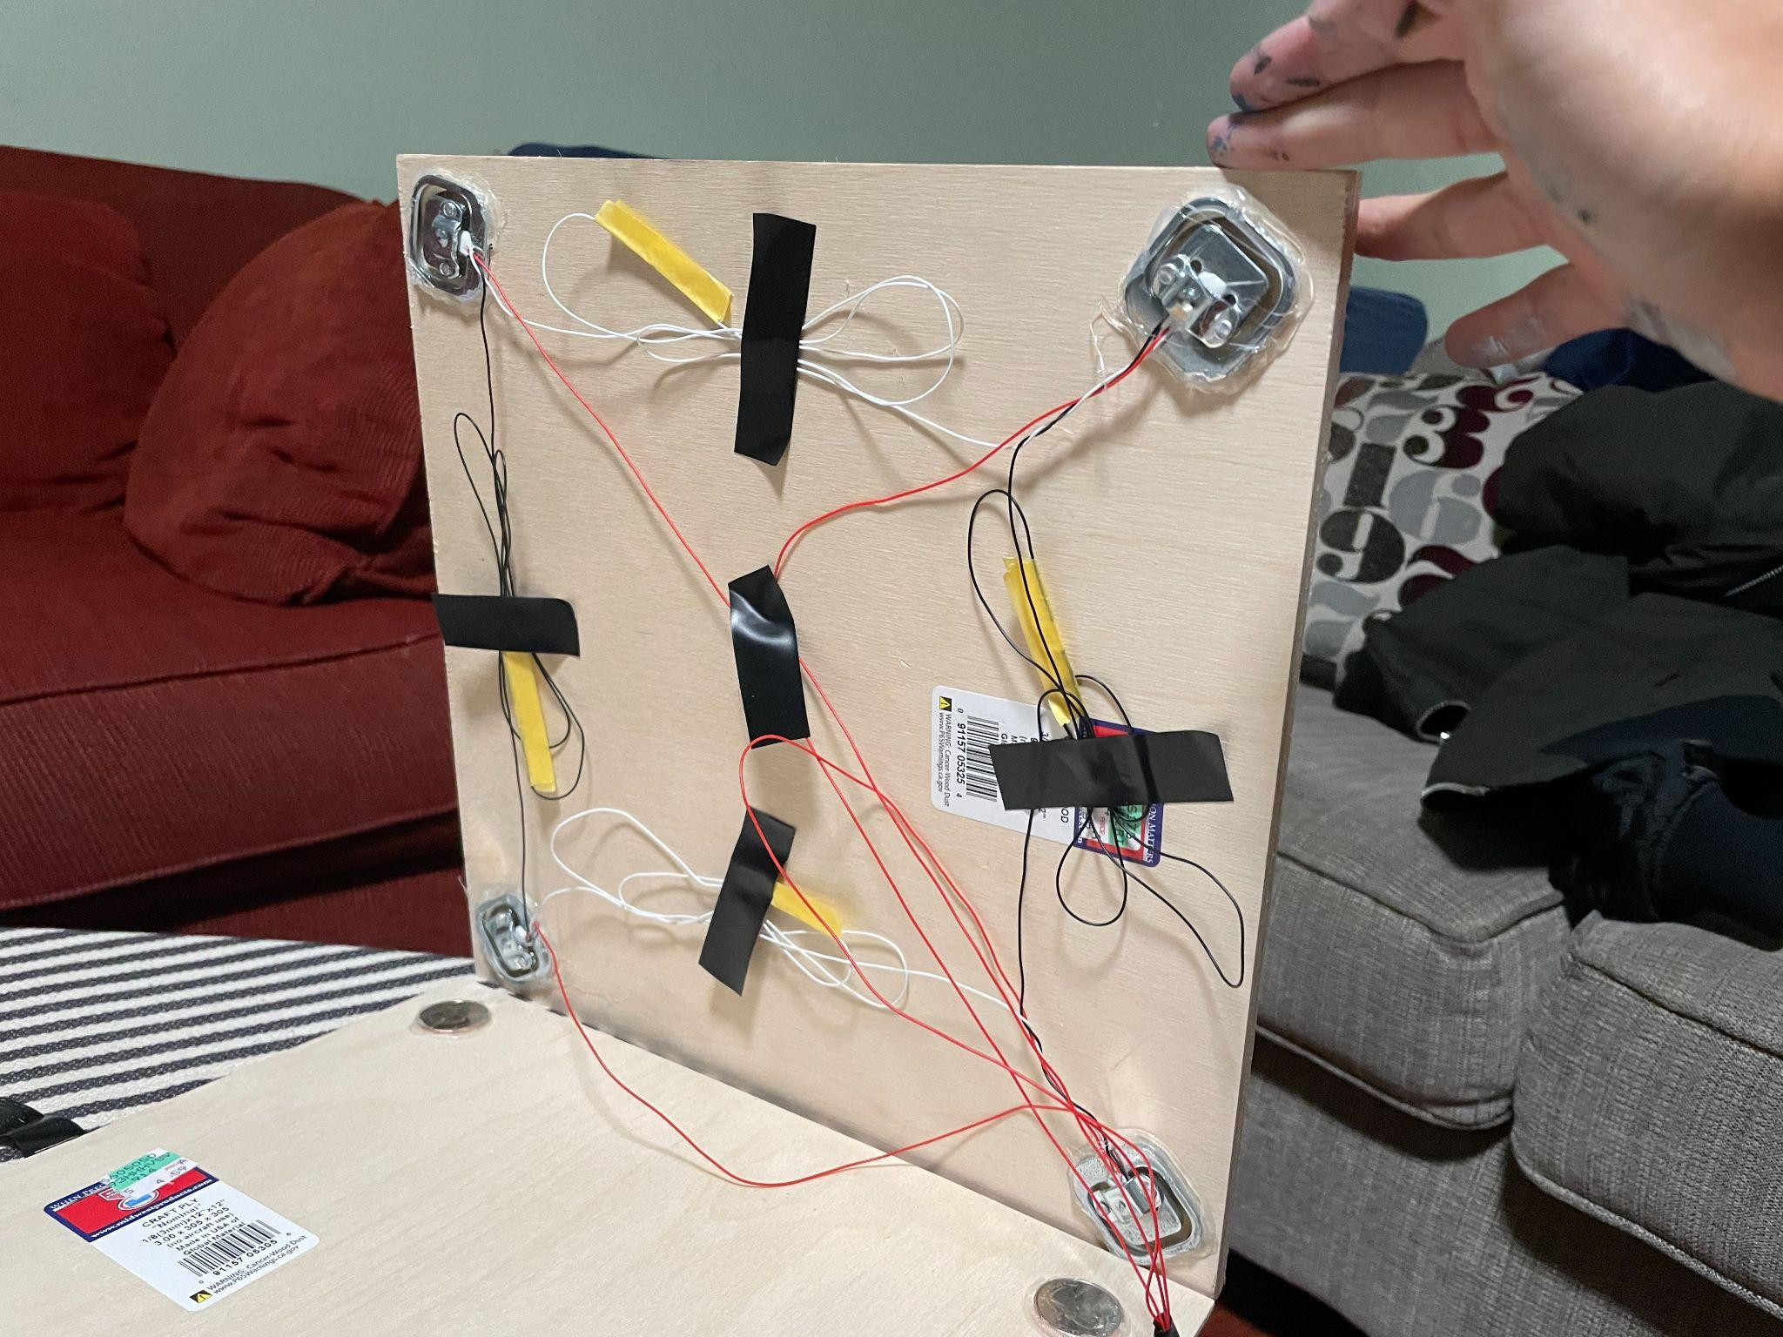
Strain Gauge (class HX711)

Slide 7
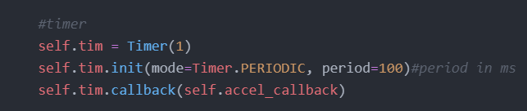
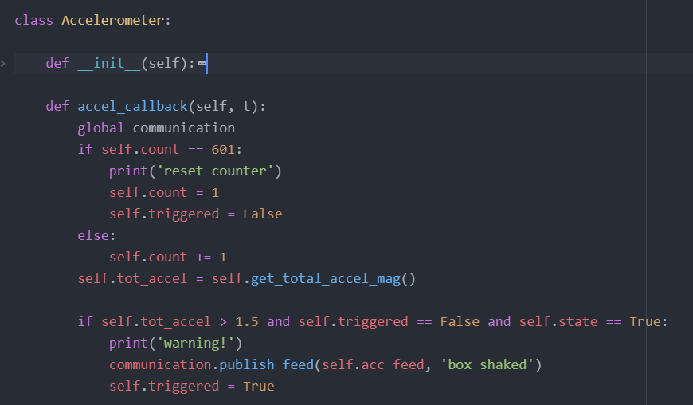
Accelerometer (class Accelerometer)
data for warning
Fast interrupts for parallel computation with main program

Slide 8
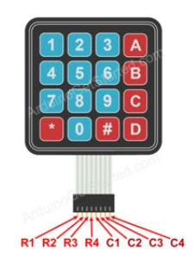
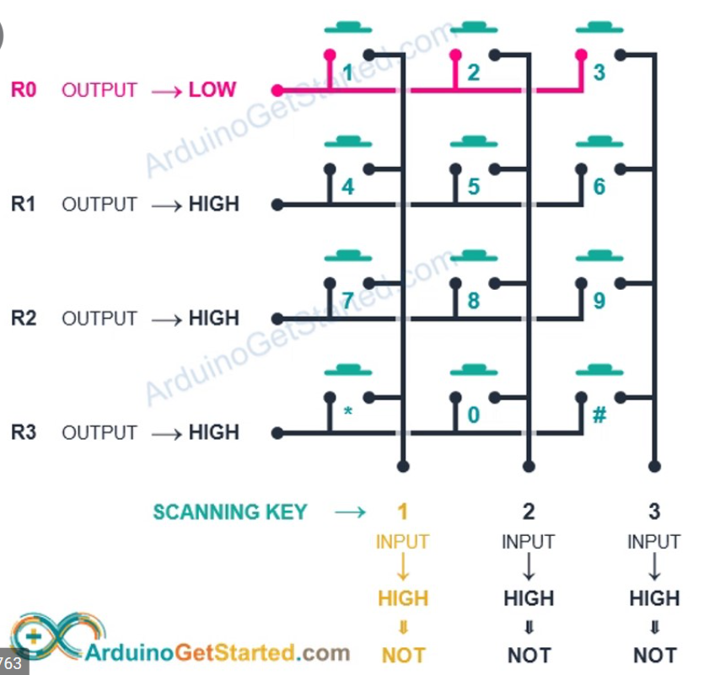
Matrix Pad (class Smartbox)
Alternate voltage of R1-4 in a for loop
Checking for voltage in C1-4
Implementation of single key input and multiple key inputs.

Slide 9
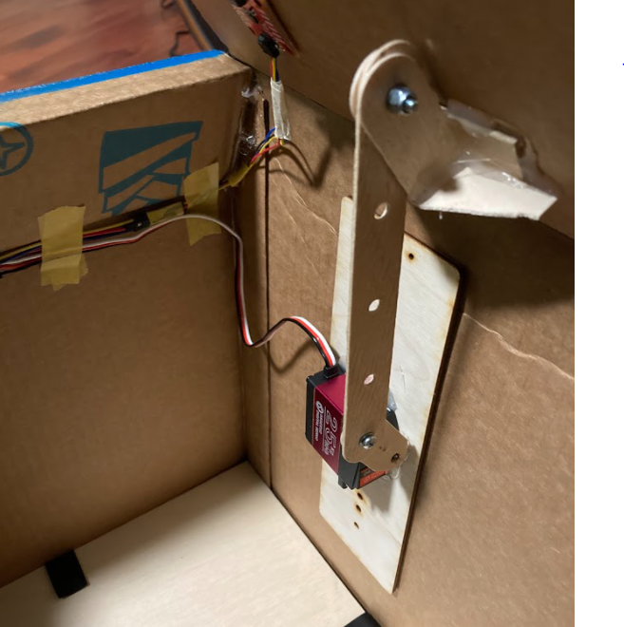
Actuators
LED (the simplest user interface)
Shows box state (on/off)
Indicates key press on Matrix Pad
Servo Motor (Lid opening / closing)

Slide 10
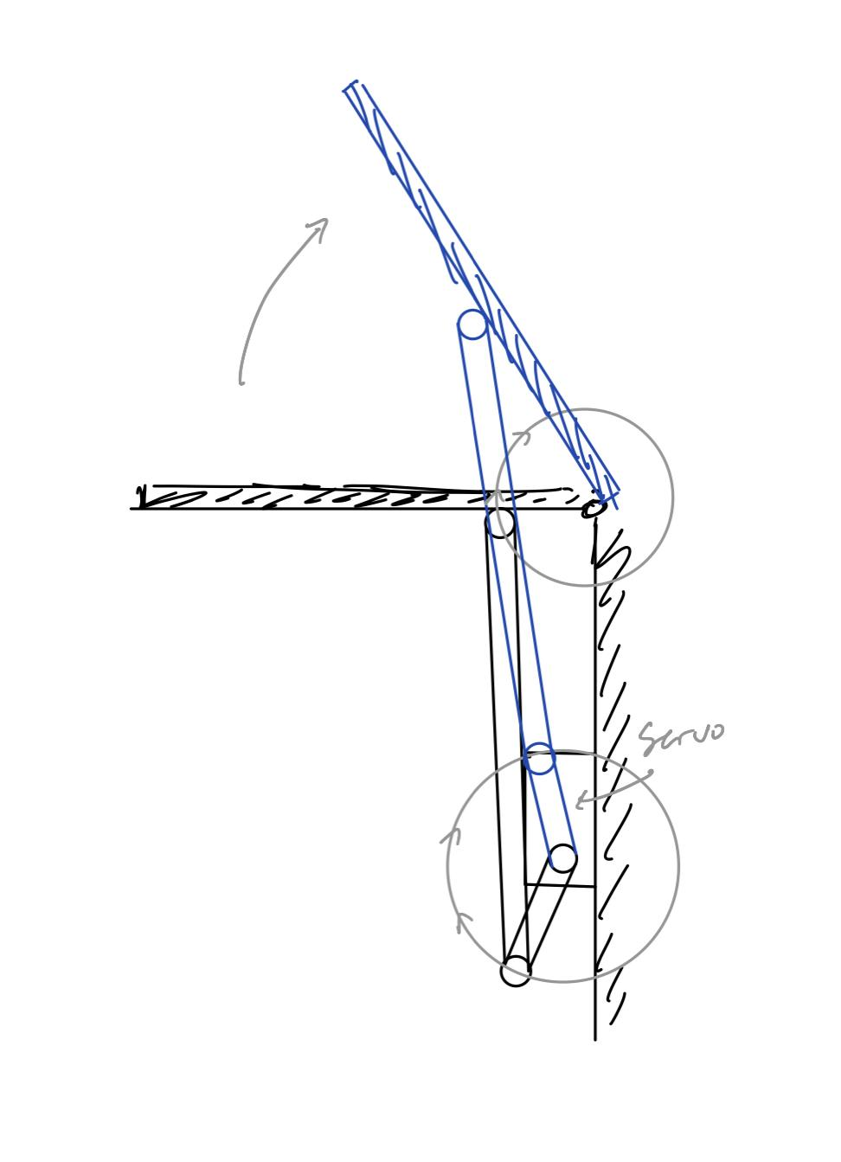
Servo Motor (class Servo)
Servo comes with microkit: 1.3kg*cm Torque
Estimated torque required to lift: 4.1 kg*cm
The servo we bought: 25kg*cm torque

Slide 11
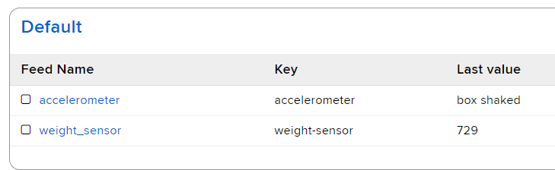
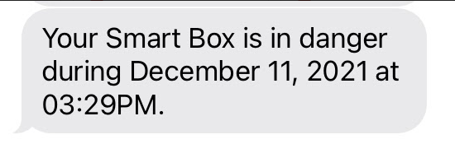

Communication (class Communication)
Two feeds in Adafruit.io
Accelerometer feed
Weight sensor feed
IFTTT
Two applets
If accelerometer value exceeds threshold, trigger message system.
Measure and report weight after delivery received by box.

Slide 12
Questions?

